Slide 1







Current Technology Usage & Future Trends
Kathryn Terpe
April 12, 2024

Slide 2
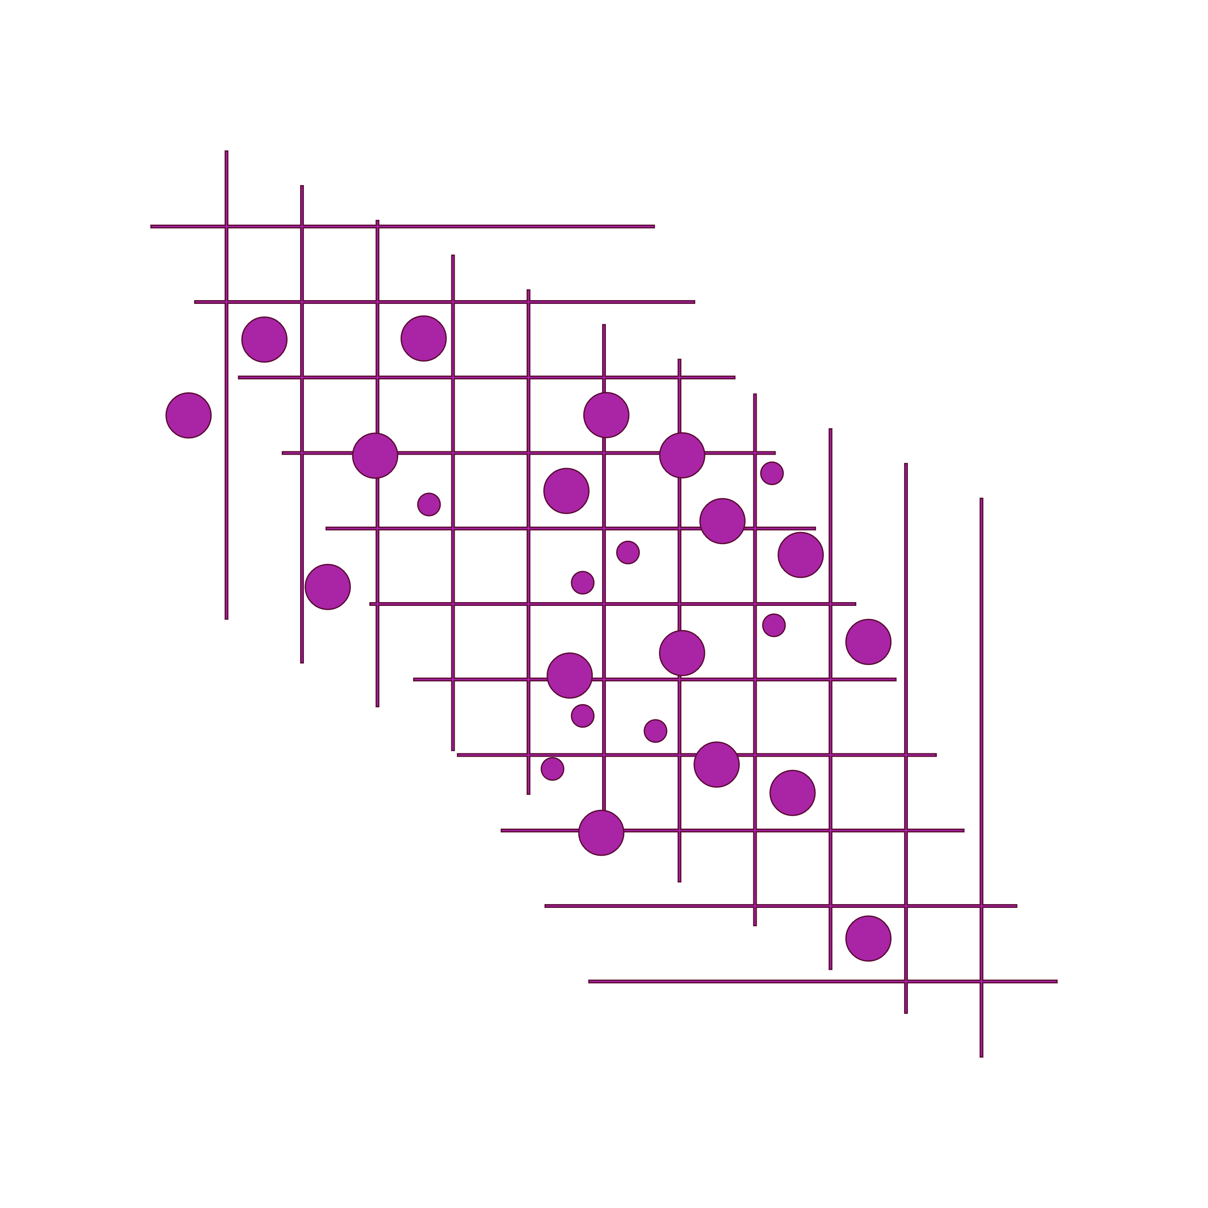


OUTLINE
Executive Summary
Introduction
Methodology
Results
Visualization – Charts
Dashboard
Discussion
Findings & Implications
Conclusion
Appendix

Slide 3

EXECUTIVE SUMMARY
Current Technology Usage
Top 10 Languages
Top 10 Databases
Platforms
Top 10 Web Frames
Technology Trends for the Next Year
Top 10 desired Languages
Top 10 desired Databases
Desired Platforms
Top 10 desired Web Frames
Demographics
Classified by Gender, per Countries
Count by Gender and Classified by Education Level

Slide 4


INTRODUCTION
Nature of Analysis:
Analyzing the trends in software development and the usage by demographics
Purpose of the Analysis:
What are the top programming languages being used today?
What are the top databases being used currently?
What Languages and databases will be popular next year?
How do demographics in gender, age and region differ from one another?

Slide 5

METHODOLOGY
Data Collection:
https://stackoverflow.blog/2019/04/09/the-2019-stack-overflow-developer-survey-results-are-in/
Data Wrangling
Data Exploration
Data Cleaning
Data Visualizations

Slide 6
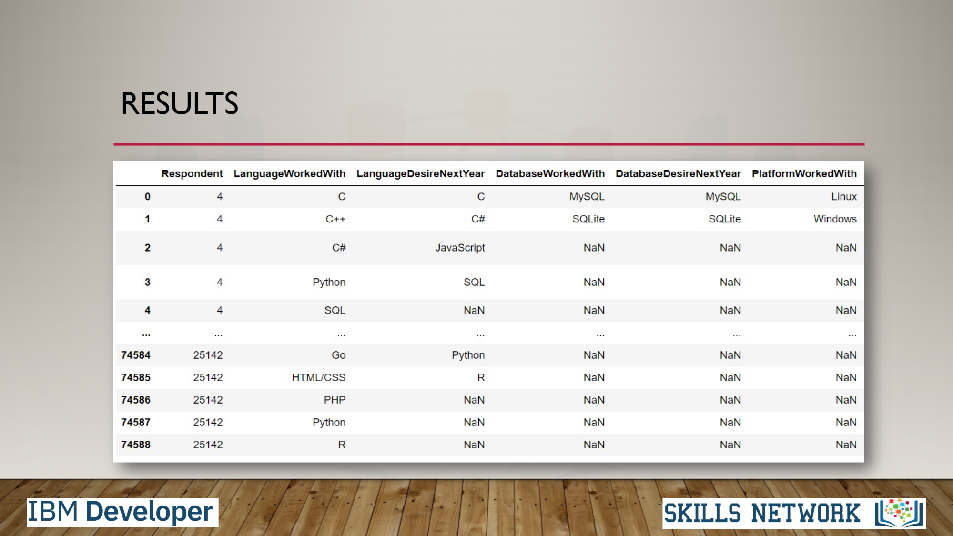
RESULTS

Slide 7
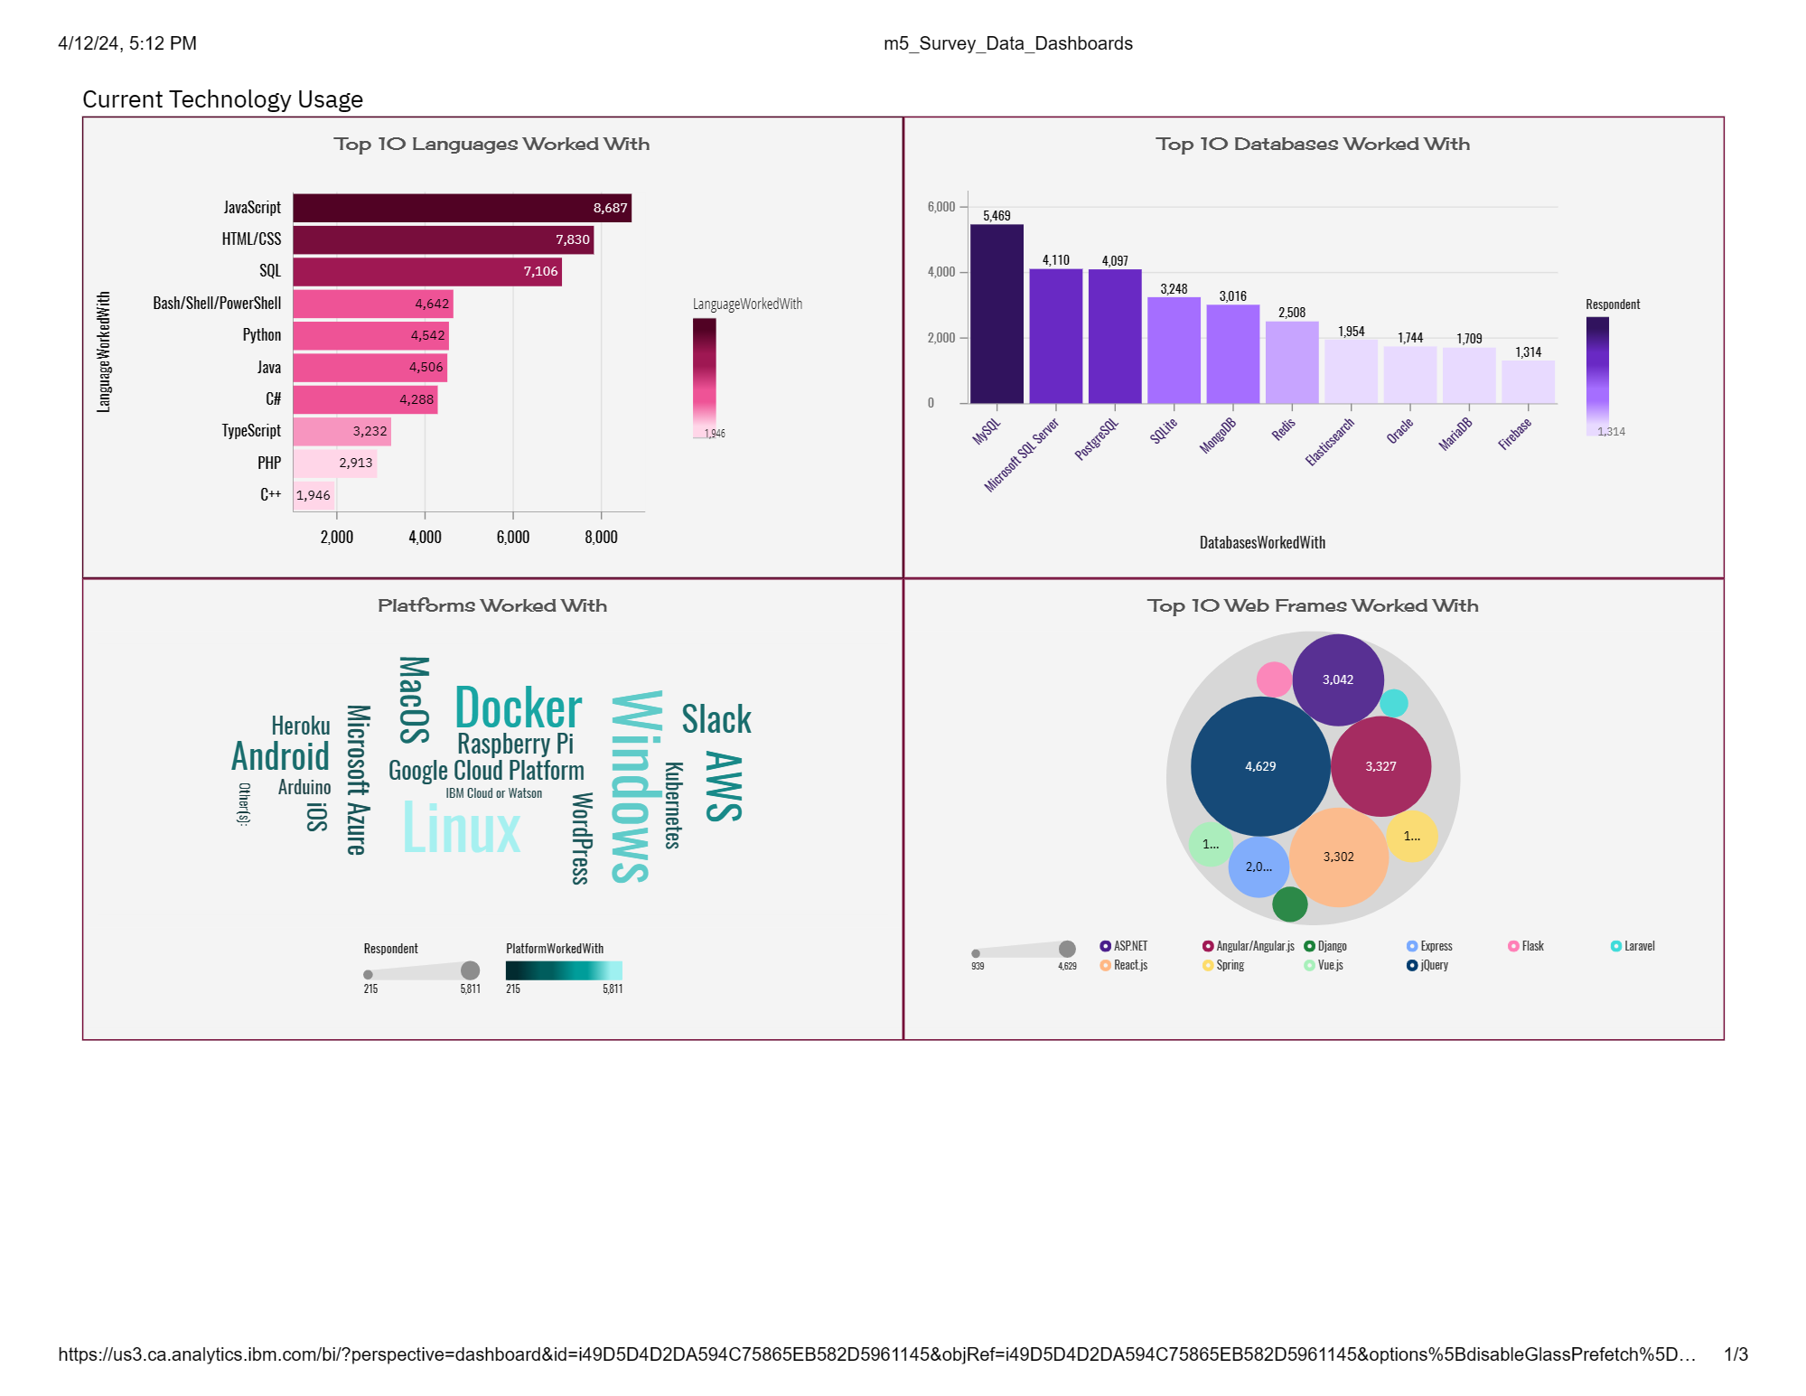
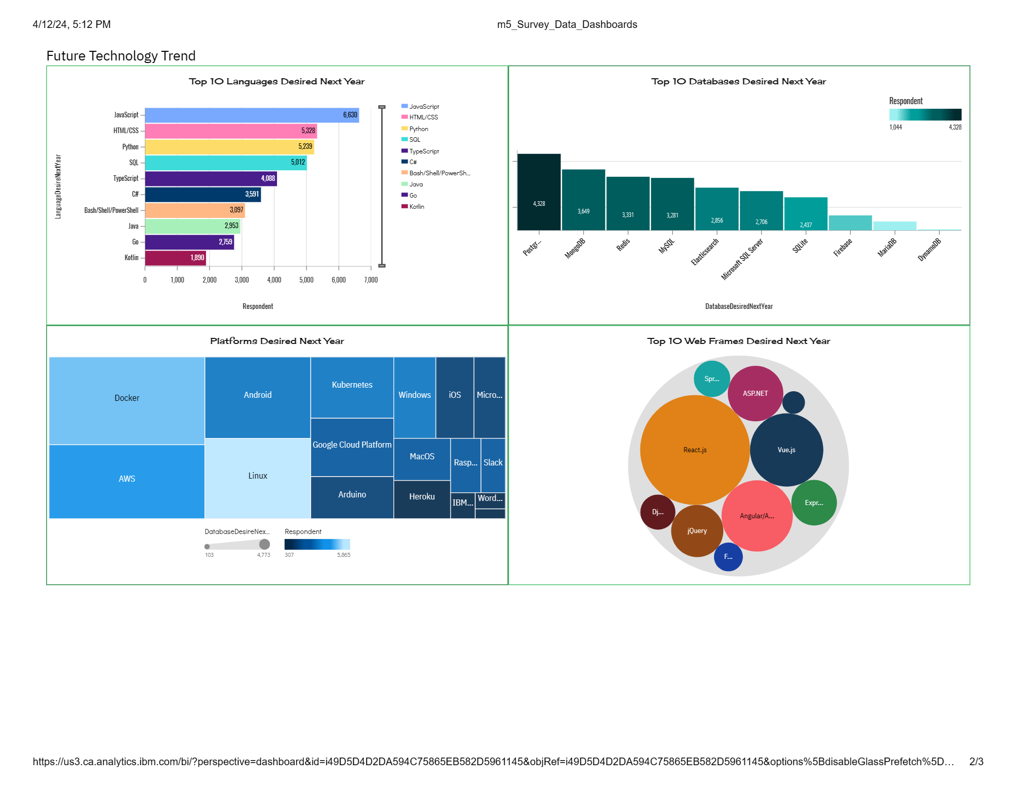
PROGRAMMING LANGUAGE TRENDS
Current Year
Next Year

Slide 8
PROGRAMMING LANGUAGE TRENDS - FINDINGS & IMPLICATIONS
Findings
JavaScript is the top trending language used currently.
TypeScript is becoming more popular and will be used quite frequently in the coming years.
JavaScript and HTML/CSS are the top programming languages that are favored and used around the world.
Implications
Python is a popular language that is widely known and an in-demand Programming Language to know
TypeScipt along with JavaScript are languages needed to know when it comes to web developments
People are more open to expanding the programming languages and learning new ones.

Slide 9
DATABASE TRENDS
Current Year
Next Year

Slide 10
DATABASE TRENDS - FINDINGS & IMPLICATIONS
Findings
SQL databases are among the most popular databases used currently
MongoDB is becoming more desirable to use within the coming year
Oracle is becoming less desirable to learn whereas databases like Couchbase, is still the least popular database choice this year as well as upcoming years.
Implications
Open-source databases are still the most desirable to learn and use
NoSQL databases are desirable to use with relational databases
PostgreSQL is becoming more desirable among respondents and becoming bigger than MySQL

Slide 11
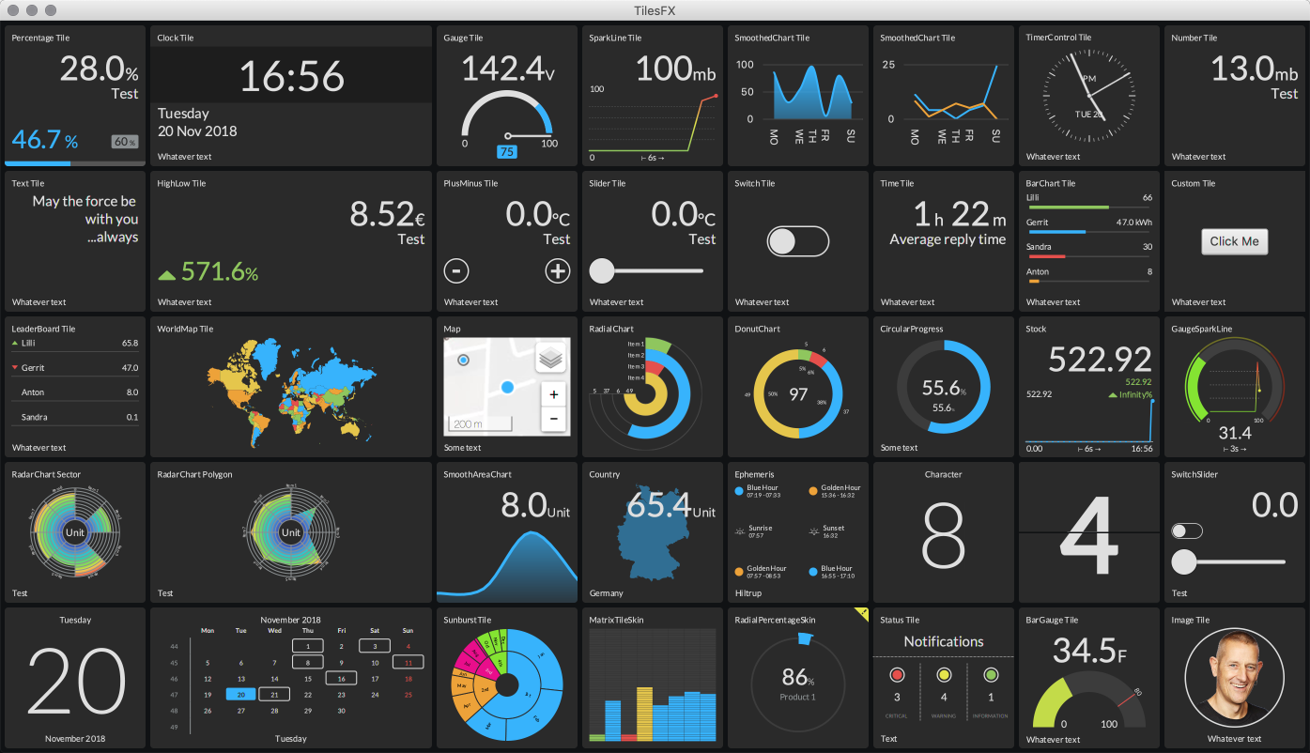
DASHBOARD
https://github.com/katieluwho132/README.md/blob/9917890a47e0dfac64dd289560fc4bbbd9a5e4b0/m5_Survey_Data_Dashboards.pdf
This Photo by Unknown Author is licensed under CC BY-NC

Slide 12
DASHBOARD TAB 1

Slide 13
DASHBOARD TAB 2

Slide 14
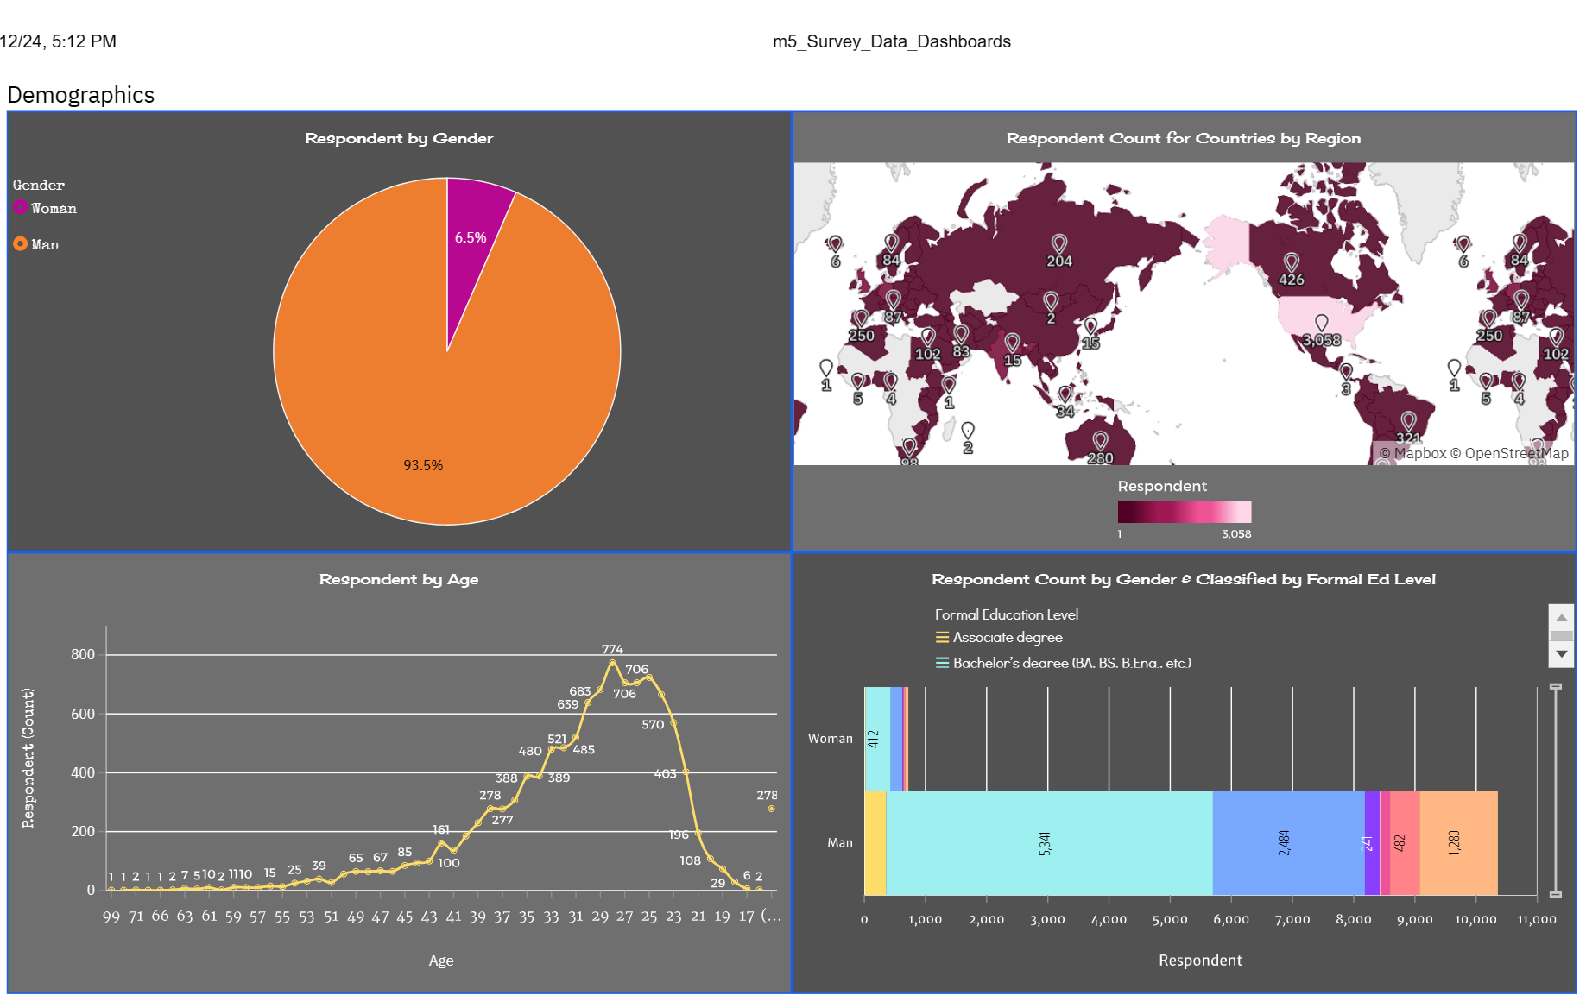
DASHBOARD TAB 3

Slide 15



DISCUSSION
People with all different educational backgrounds were asked to partake in the survey
People from all around the world in a multitude of different countries were included in the survey
All genders and sexual orientations were included as well
Survey demographics come from a wide range of different backgrounds

Slide 16
OVERALL FINDINGS & IMPLICATIONS
Findings
Programming Languages differ in popularity every year
Docker along with AWS is the more desired platform to work with
There are a lot more male than females in the Web Developing world, or at least that were asked for the participation of this survey
Implications
Web Developers and Programmers should stay up to date with the newest and most desired programming languages, databases and platforms because they are always changing.
Technology is vastly growing and new ways to use it and build with it will always be crucial to learn and understand

Slide 17

CONCLUSION
Technology Trends now and to come
Programming Languages, Databases and Platform Trends being used and growing in popularity
Demographic Trends
Countries by gender with classification by formal education level trends

Slide 18
APPENDIX

Slide 19
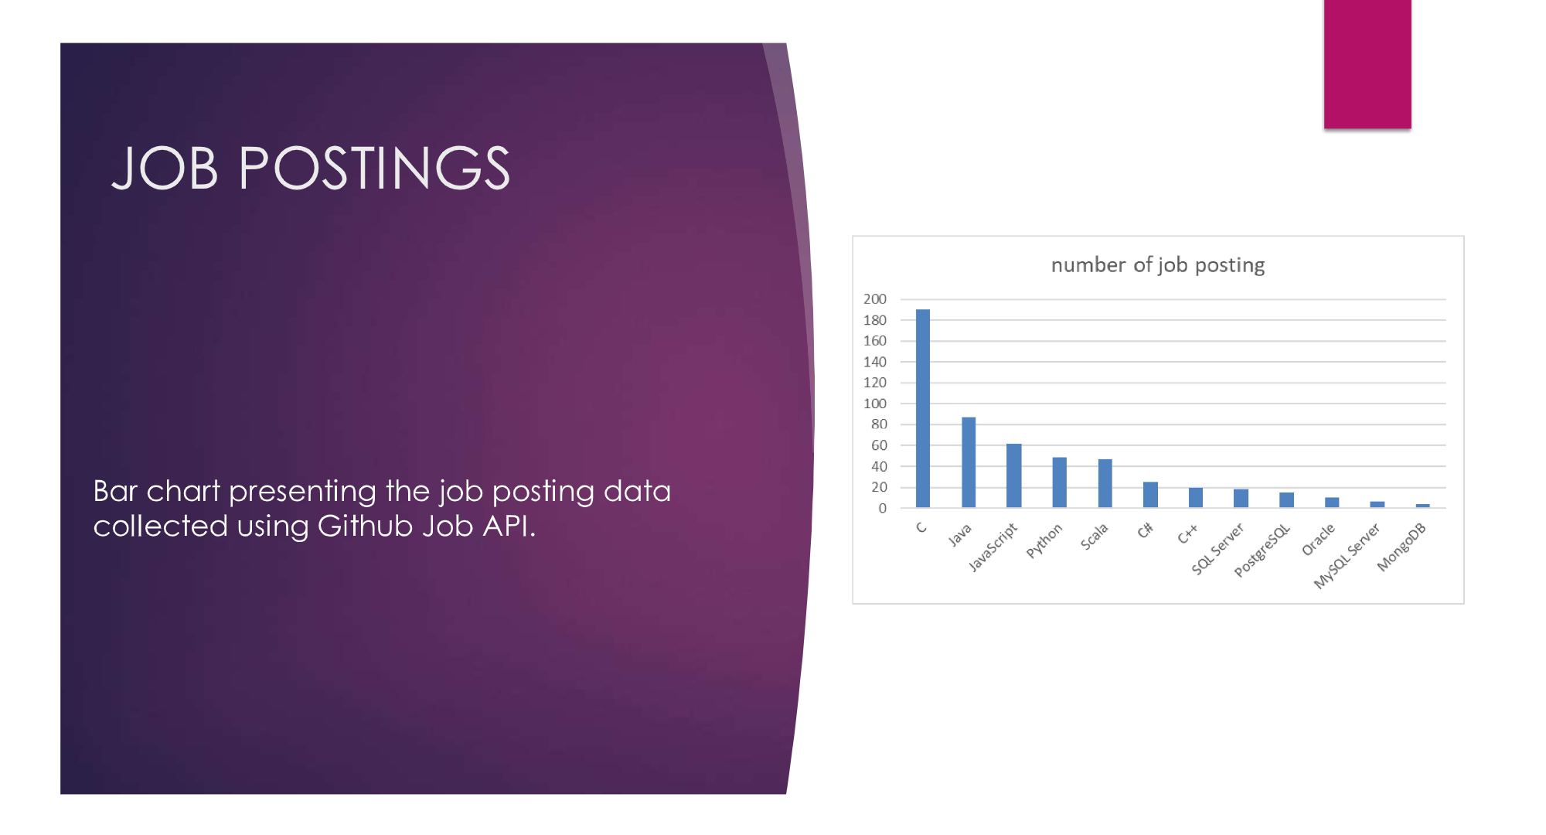
JOB POSTINGS

Slide 20
POPULAR LANGUAGES
In Module 1 you have collected the job postings data using web scraping in a file named “popular-languages.csv”. Present that data using a bar chart here. Order the bar chart in the descending order of salary.

